Slide 1
TEAM NATURAL INTELLIGENCE msds6306: DOING DATASCIENCE Case Study 2
MICHAEL J WOLFE
AYOADE G DARE

Slide 2



DDSANALYTICS INC.
TALENG MANAGEMENT PROJECT

Slide 3
TABLE OF CONTENTS
PROBLEM STATEMENT
EXPLORATORY DATA ANALYSIS
RANDOM FOREST ALGORITHM
OBSERVATIONS
RECOMMENDATIONS
CONCLUSION

Slide 4
PROBLEM STATEMENT
Reduce employee turnover (attrition)
Improve talent management process to develop and retain employee
Identify top three factors that contribute to turnover
Identify job role trends that exist in the data set

Slide 5
Deliverables
Exploratory Data Analysis
Machine Language Algorithm Comparison
Machine Learning Model Optimization & Fine-Tuning
Turnover (attrition) Prediction
Recommendation

Slide 6
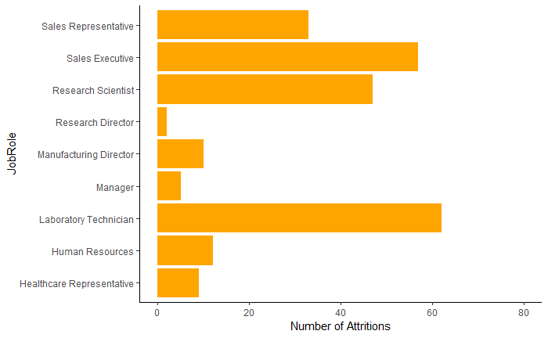
Exploratory data analysis

Slide 7
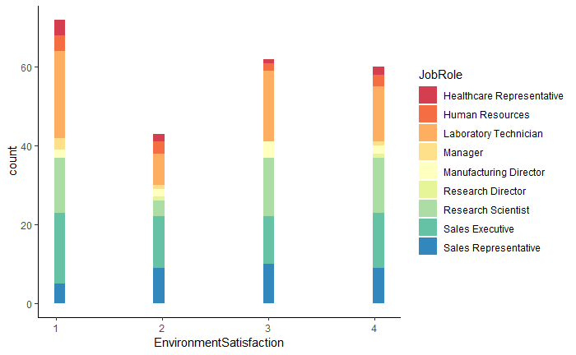
EXPLORATORY DATA ANALYSIS

Slide 8
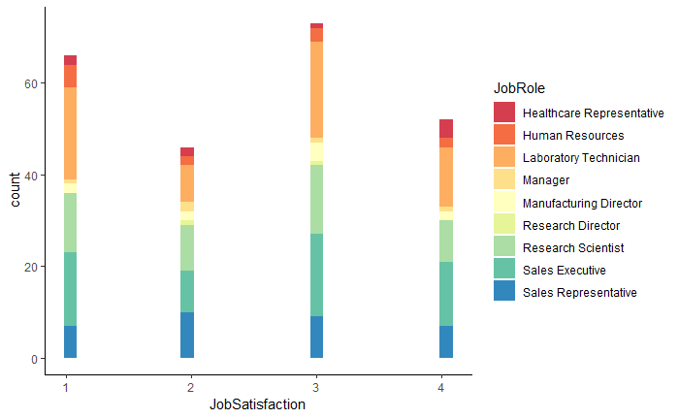
Exploratory data analysis

Slide 9
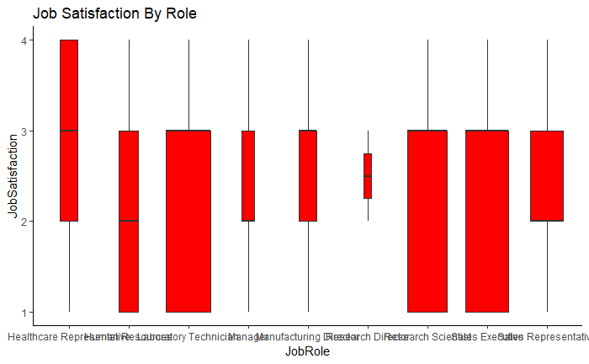
Exploratory data analysis

Slide 10
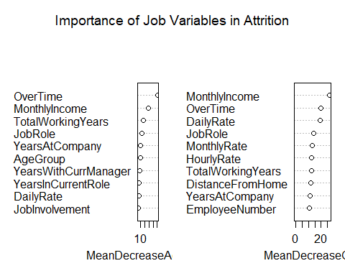
Variables by importance

Slide 12
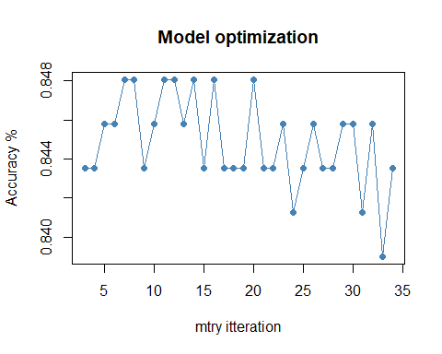
Mtry iteration

Slide 13
OBSERVATIONS

Slide 14
CONCLUSION/rECOMMENDATIONS

Slide 15
QUESTIONS

